Slide 1

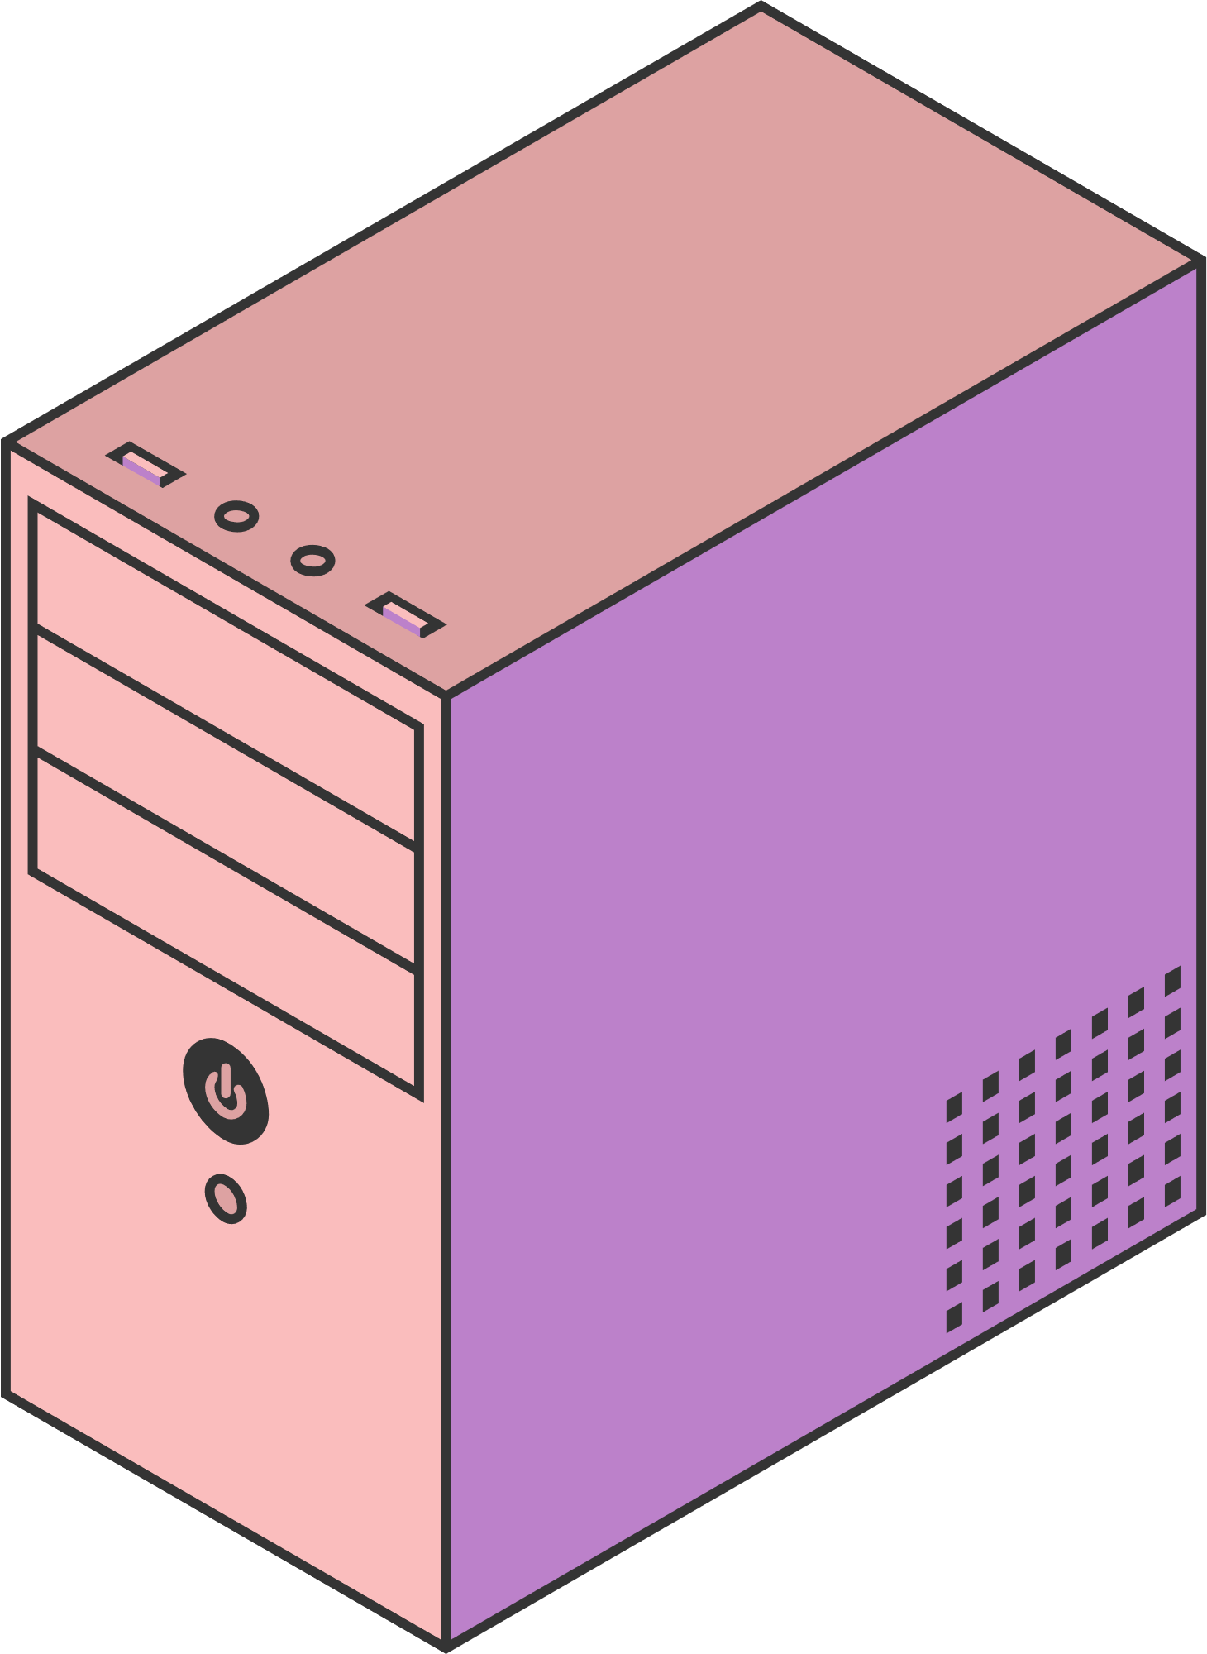
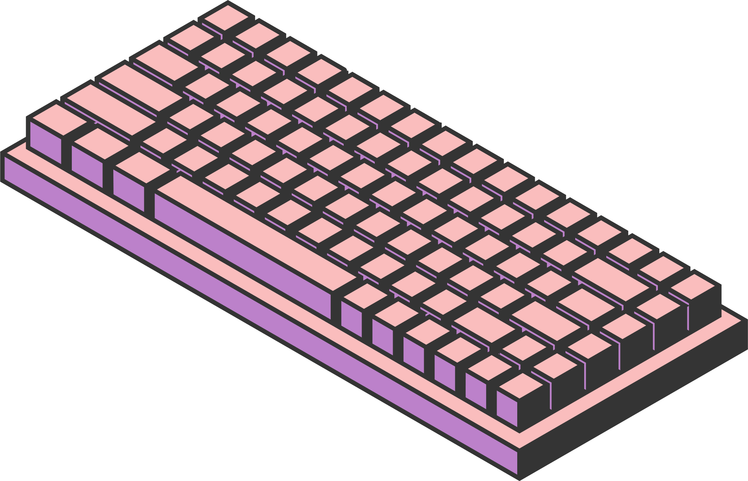
CAR REVIEW
SEARCH ENGINE
Christopher Schneider - up202401397
Daniel Samuel Edim - up202400301
Luis Vieira Relvas - up202108661
Rodrigo Campos Rodrigues - up202108847
Page 01

Slide 2


OUR OBJECTIVES
For this milestone, we developed a final version of the search engine system. As expected, this version attempts to improve on the previous milestone, using new features and techniques.
Agenda + Techniques and Features Explored:
Milestone 2 Review
Semantic Search
Boolean Query Parser
Search User Interface
More Like This
Re-Ranking with LLM
Page 02

Slide 3

MILESTONE 2 REVIEW
Two search engines were implemented:
Simple Schema:
Tokenizer:
solr.StandardTokenizerFactory
Filters:
solr.ASCIIFoldingFilterFactory
solr.LowerCaseFilterFactory
Boosted Schema:
Tokenizers:
solr.StandardTokenizerFactory
Filters:
solr.ASCIIFoldingFilterFactory
solr.LowerCaseFilterFactory
solr.SynonymGraphFilterFactory
solr.EnglishMinimalStemFilterFactory
Page 03

Slide 4
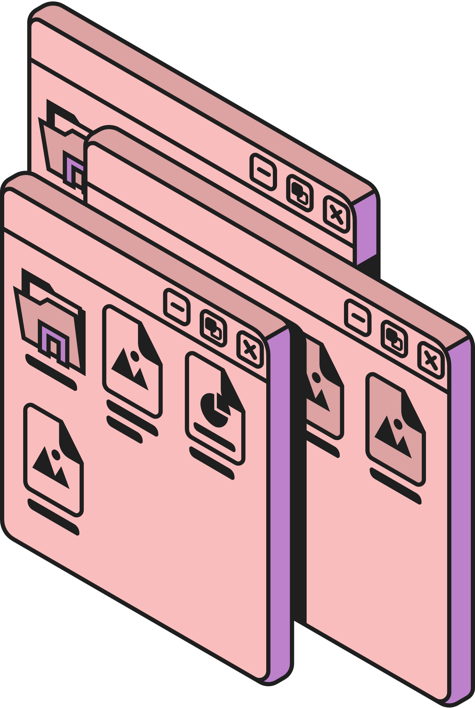

SEMANTIC SEARCH
Based on the Boosted Schema, we developed a new one: Semantic Schema.
The only difference between these two schemas is in the way they process queries.
To accomplish this, three steps were taken:
Used a script to generate embeddings for our documents.
Extended the previous Boosted Schema by adding a new field to store the embeddings generated.
Used the K-Nearest Neighbor query parser to get the retrieved documents.
Page 04

Slide 5

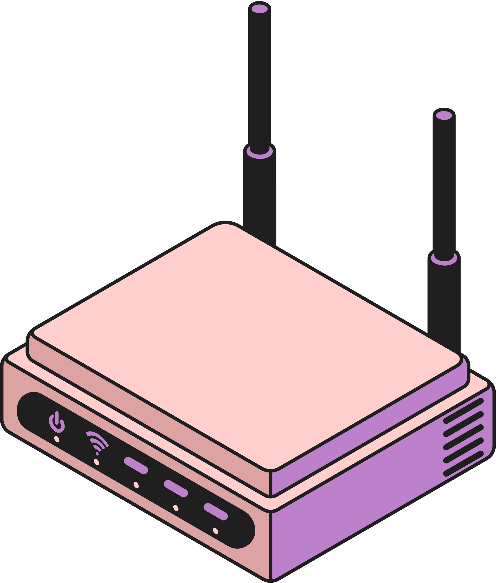
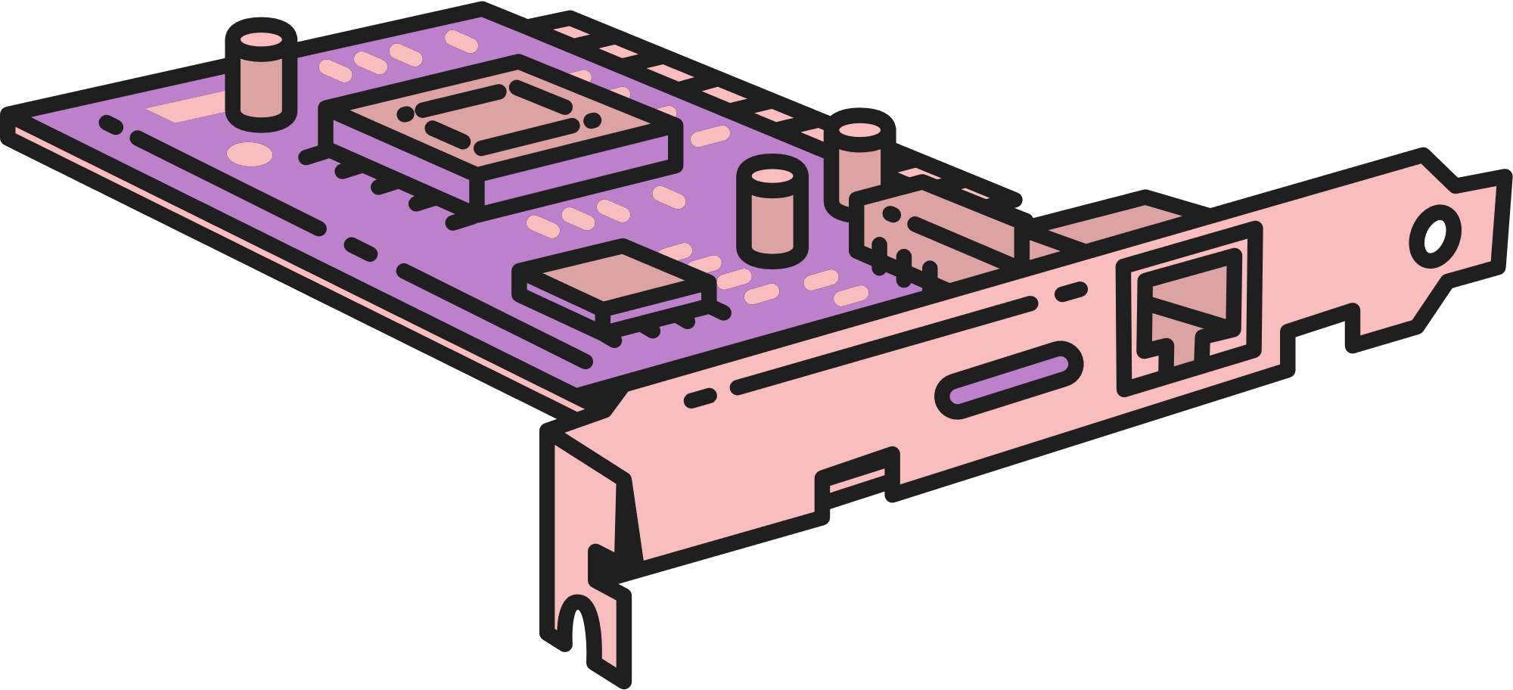
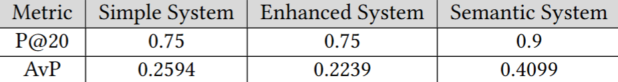
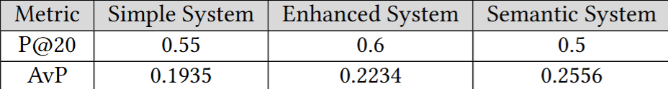
COMPARISON
SEMANTIC VS PREVIOUS SYSTEMS
After running and evaluating the queries in boosted and semantic systems:
only one query the semantic performed better than the boosted.
Two examples of the evaluation from the semantic system compared to the boosted system:
Information Needs : Modern Design Cars
Information Needs : Family cars with reasonable price
Page 05

Slide 6

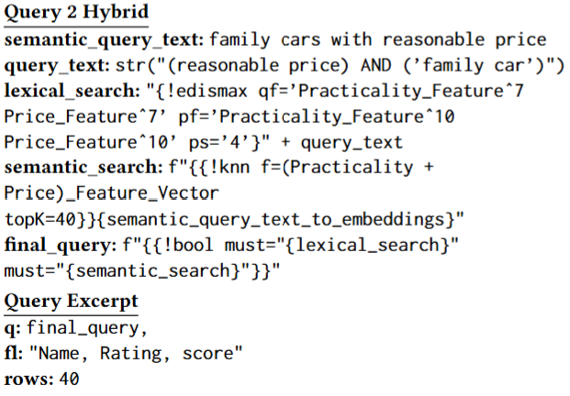
BOOLQPARSER
Exploring Boosted and Semantic Systems
Semantic search results were inconsistent.
Explored BoolParser to mix boosted and semantic systems.
BoolQParser creates Lucene Boolean Query.
Allows simultaneous execution of semantic and boosted queries for more accurate results.
Page 06
Notes:
As the results from the semantic search were not so consistent as we were expecting, we decided to explore a new system, that would mix the boosted and the semantic systems.
For this purpose, we explored other Parsers as options and found the BoolQParser.
The BoolQParser creates a Lucene Boolean Query which is a boolean combination of queries.
Instead of running the semantic and the boosted queries isolated, we can now run, using this parser, both at the same time and generate more accurate results.
we decided to augment the volume of documents produced by a query from 20 to 40, leading to larger qrel files and differences in the evaluation metrics calculated before.

Slide 7

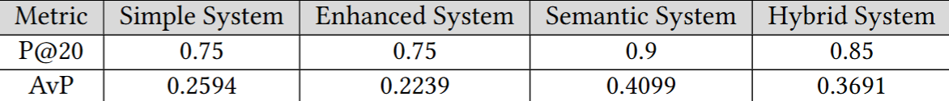
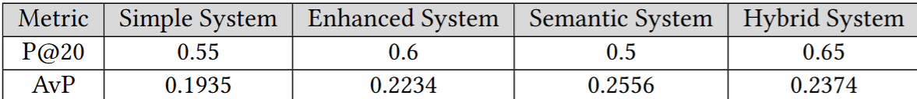
COMPARISON
BOOLQPARSER VS PREVIOUS SYSTEMS
Expectation: Improved Semantic Search System Performance and generation of better results than base version.
Lacks precision in all queries.
P@20 is better in some cases.
Information Needs : Modern Design Cars
Information Needs : Family cars with reasonable price
Page 07
Notes:
At this point, as it was expected, the new improved version of the semantic search system generated better results than the base one.
However, it wasn’t still enough to be more precise in all queries than the Enhanced System, even though in some cases the P@20 is better.

Slide 8
EVALUATION
QUERY 1 CONCLUSION
Information Needs : Cars with modern design
Semantic and Hybrid Systems' Power in Concept-Driven Information
Utilizes dense vector embeddings for document retrieval.
Can indirectly reference modernity through synonyms or related terms.
Overlooks traditional keyword-based approaches.
Page 08
Notes:
This query shows how powerful the semantic and the hybrid systems can be in addressing concept-driven information needs.
The dependence on the dense vector embeddings enables it to retrieve documents that indirectly reference modernity through synonyms or conceptually related terms, which traditional keyword-based approaches may overlook.

Slide 9
EVALUATION
QUERY 2 CONCLUSION
Information Needs : Family cars with reasonable price
Dynamic Semantic Search
Achieves a balance between cost-effectiveness and family-oriented attributes.
P@20 somewhat decreased compared to prior systems.
AvP exceeds both, indicating superior ranking quality.
Semantic systems provide worse outcomes for aligning technical feature-based requirements.
Page 09
Notes:
In this query, the semantic search shows an interesting dynamic, which involves a balance between cost-effectiveness and family-friendly features.
The P@20 is slightly lower than both the previous systems, although its AvP surpasses both, indicating better ranking quality across the entire set of retrieved results.
It is also noticeable that when it comes to matching technical feature-based requirements, the semantic systems also tend to generate worse results.

Slide 10
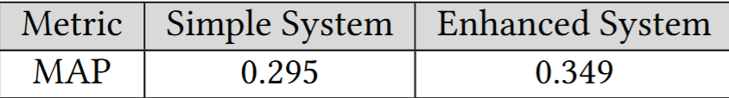
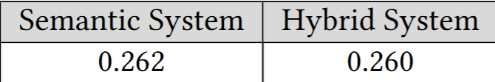
EVALUATION CONCLUSIONS
Augmented System Performance Evaluation
The Enhanced System established in the preceding milestone surpassed the others
Various systems exhibit superior performance owing to distinct situations.
Page 10
Notes:
In the table above, it is noticeable that the system that performed better is the Enhanced System implemented in the previous milestone.
It is important to emphasize that the MAP displayed in the above table represents a mean, and as we just seen in the last slides, there are system that perform better due to different circumstances.

Slide 11
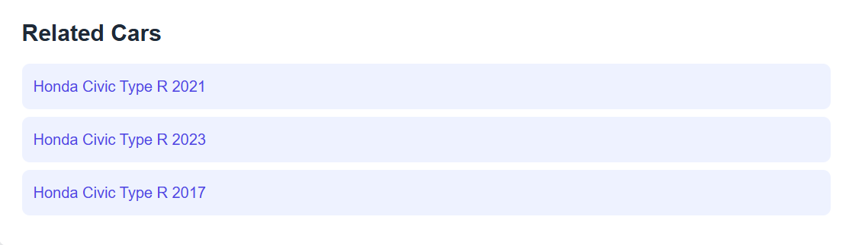
MORE LIKE THIS
More Like This, also known as MLT, is a featured used to search for similar documents to a given input.
It starts by analysing the most significant terms from the input and matching those terms against the ones indexed in Solr.
We decided to use this feature in the User Interface, after selecting a specific car. Inside the car page, the user, we will have a related section that will give related documents to the one previous selected.
Page 11

Slide 12
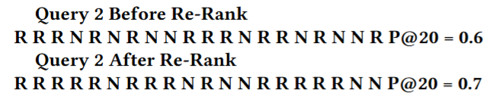
RE-RANKING
To better align with End-User goals, we have implemented a re-ranking process.
Re-Ranking reorders the documents retrieved by the Enhanced System based on an advanced scoring mechanism. In this case, we used Gemini, a large language model (LLM).
This decision to use Gemini is based on its ability to improve the ranking by using its comprehensive knowledge about cars.
This will allow the system to show first the documents more relevant and accurate, increasing the user experience.
Page 12

Slide 13
FINAL SYSTEM
Hybrid System combines semantic and enhanced systems for structured queries.
Offers precision and ranking quality as an alternative to advanced systems.
Baseline and boosted systems perform better for exact keyword matching and descriptive queries.
Semantic and hybrid systems are more effective for general queries.
User-Interface system is Enhanced.
Page 13
Notes:
As explained before, the hybrid system effectively combines semantic and enhanced systems, making it well-suited for structured and intent-driven queries. It excels in precision and ranking quality, offering a good alternative to advanced systems.
The baseline and boosted systems perform better for exact keyword matching and descriptive queries, while the semantic and hybrid are more effective for general queries.
The system used in the User-Interface is the Enhanced.

Slide 14
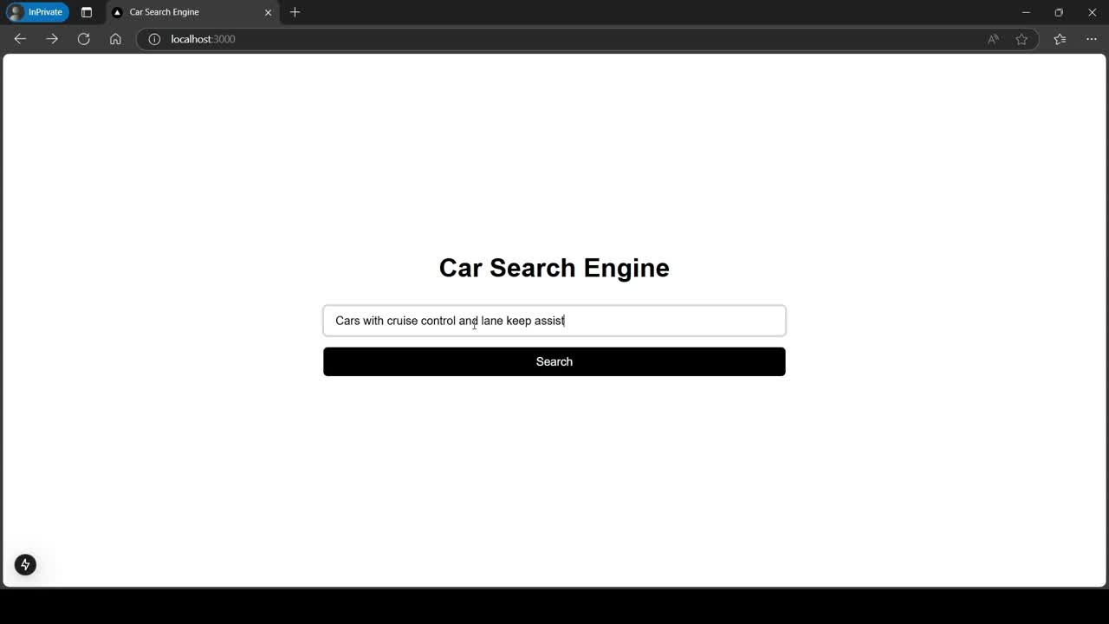
Page 14

Slide 15



REFERENCES
Apache Solr. Solr: Open-Source Search Platform. Accessed November 14, 2024.https://solr.apache.org/.
Apache Solr. The Extended DisMax. Accessed November 14, 2024. https://solr.
apache.org/guide/6_6/the-extended-dismax-query-parser.html.
Apache Solr. Filters. Accessed November 14, 2024.https://solr.apache.org/guide/
solr/latest/indexing-guide/filters.html.
Apache Solr. The Standard Query Parser. Accessed November 14, 2024.https://solr.apache.org/guide/8_7/the-standard-query-parser.html.
Apache Solr. Other Parsers. Accessed 15 November.https://solr.apache.org/guide/7_7/other-parsers.html#boolean-query-parser
U.S. NIST. Trec Eval Tool for Information Retrieval Evaluation. Accessed November 14, 2024. https://github.com/usnistgov/trec_eval.
Page 15

Slide 16
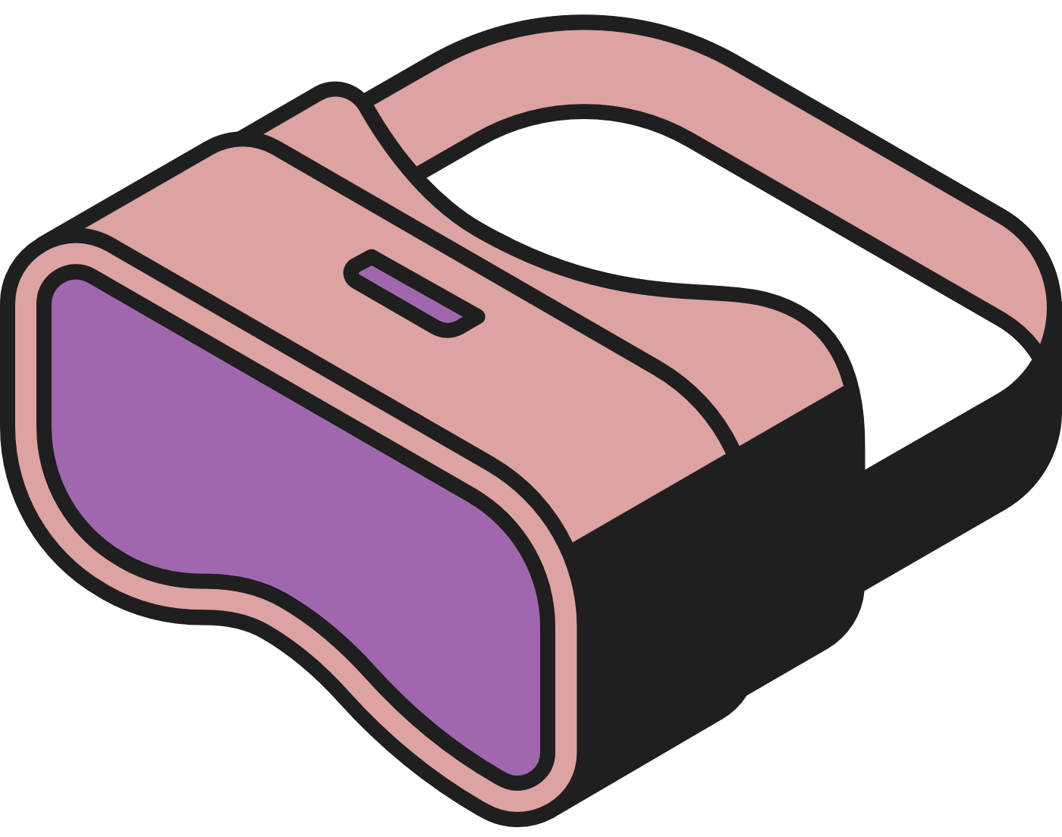



THANK YOU
Page 16

